Slide 1
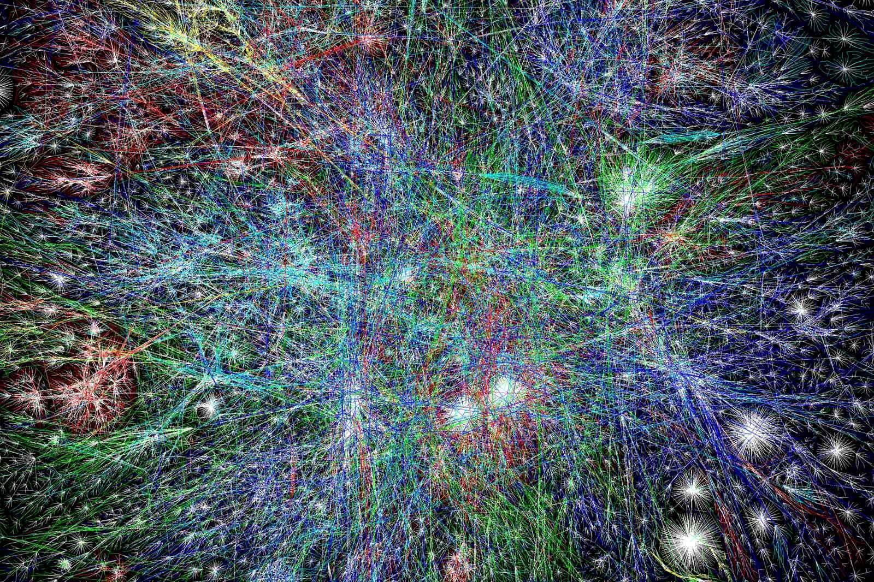
Agent-Based Modeling Workshop
Morgan DiCarlo
Liz Ramsey
Image credit: https://www.futurelearn.com/courses/complexity-and-uncertainty

Slide 2
PLEASE DOWNLOAD NETLOGO
https://ccl.northwestern.edu/netlogo/download.shtml

Slide 3
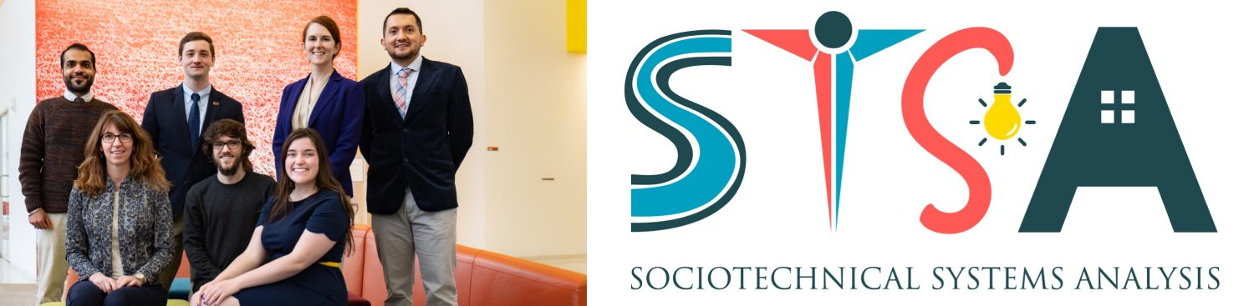
Who We Are:
Morgan DiCarlo
-PhD student
-Research on water-related natural disasters and social media communications
Liz Ramsey
-PhD Student
-Research on water scarcity, migration patterns, and civil unrest

Slide 4








OVERVIEW
Intro to ABMs
Activity: Create a Netlogo environment
Demo: Predator/Prey Dynamics
Activity: Examine a Traffic Jam
Demo: Simulating Segregation
Activity: Predicting Forest Fires
Demo: El Farol model
Demo: ABM with Python

Slide 5


Slide 6

HEROES AND COWARDS
Rules:
Everyone stand up!
Arbitrarily choose someone in the room to be your “friend”
Choose someone else to be your “enemy”
Don’t tell anyone who you have chosen!
Move to position yourself such that:
You are behind your friend relative to the enemy (HIDING)
What might happen?
Notes:
rich, complex, and surprising behavior can emerge from simple rules and interactions.
The results are striking: almost instantaneously the whole room will implode, with everyone clustering in a tight knot. This example shows how simple individual rules can lead to coherent group behavior, how small changes in those rules can have a dramatic impact on the group behavior, and how intuition can be a very poor guide to outcomes beyond a very limited level of complexity. ‘Your collectiev behavior is what we call an emergent phenomena

Slide 7
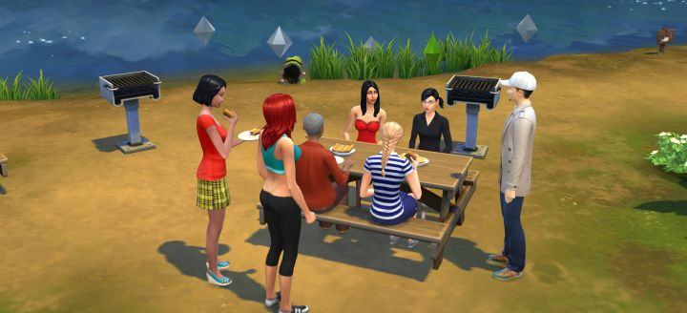
WHAT ARE ABMS?
Agent Based Models are computer models of complex systems
They are designed to simulate how individual behaviors can influence system-wide dynamics
Just like The SIMs™ computer games:
Agents interact with each other and their environment
Agents have individual attributes that define them
Interactions take place over a simulated timeline
PC: Carl’s Sims 4

Slide 8
APPLYING ABM
ABMs are most useful for problems that meet these criteria:
● Complicated interaction between agents
● Randomness in the real-world system
● Population size should be big
● But not too big
10 - 1 million agents
Notes:
Rough time: 12:05

Slide 9
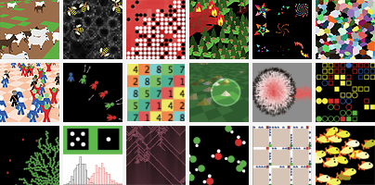
WHAT IS NETLOGO?
Programmable modelling environment for complex systems
Developed by Uri Wilensky in 1999
User-friendly syntax
Allows us to visualize the macro-level patterns that emerge from micro-level behaviors

Slide 10
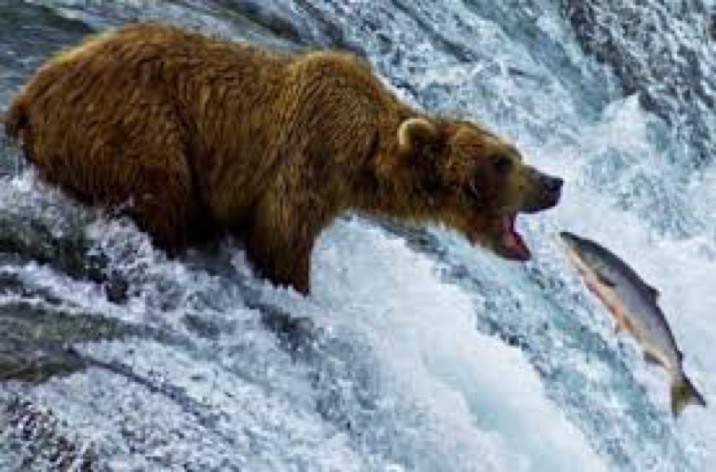
DEMO: PREDATOR-PREY DYNAMICS

Slide 11
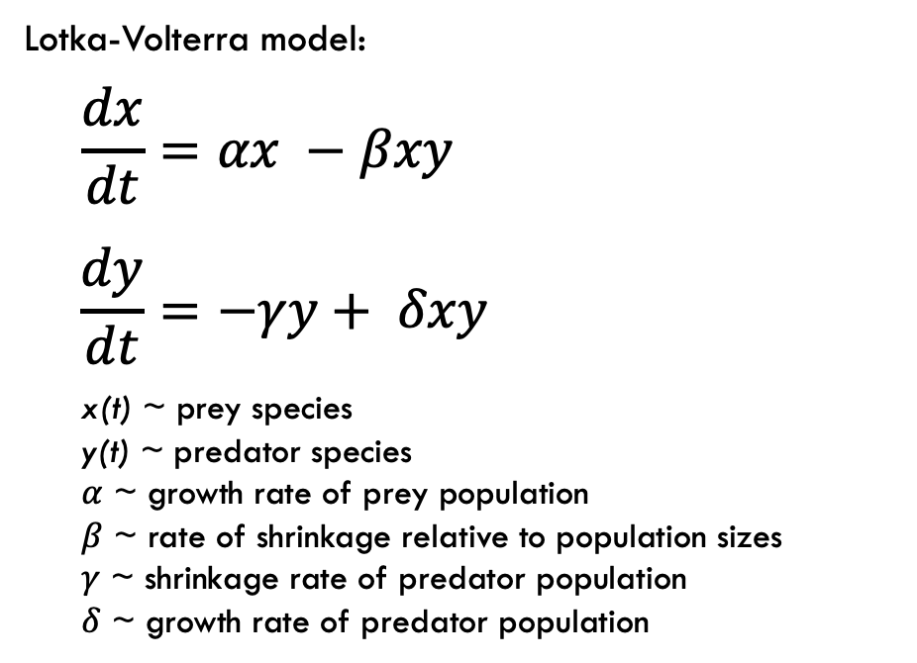
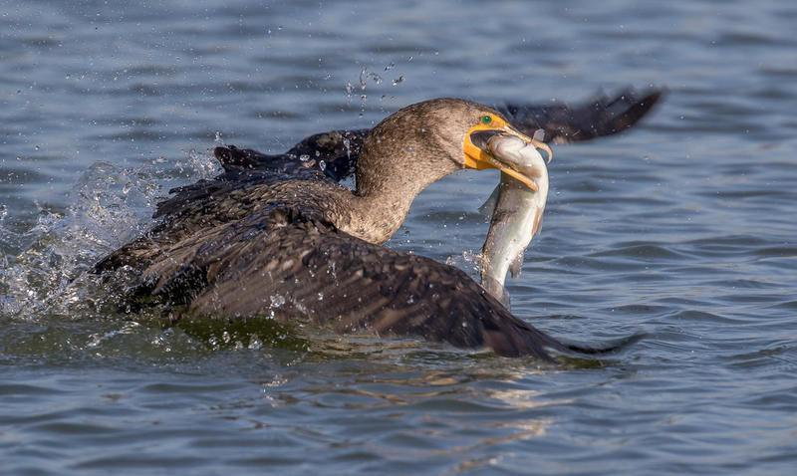
PREDATOR-PREY DYNAMICS- ANALYTICAL SOLUTION
Notes:
12:35

Slide 12
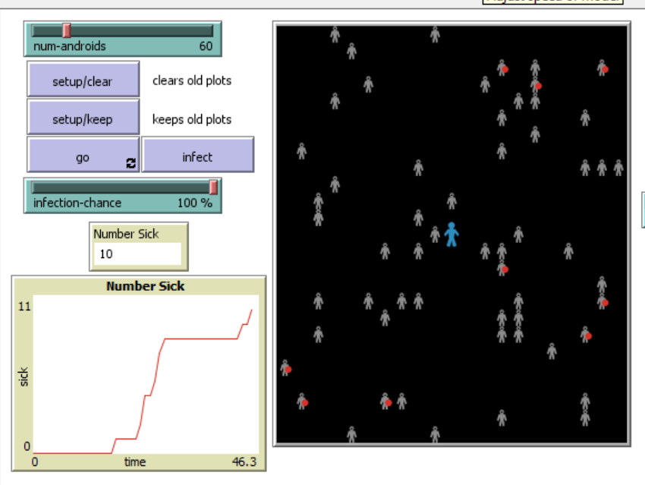
NETLOGO GUI
Tool to let you add:
Agents
Buttons
Graphics
Controllable sliders

Slide 13
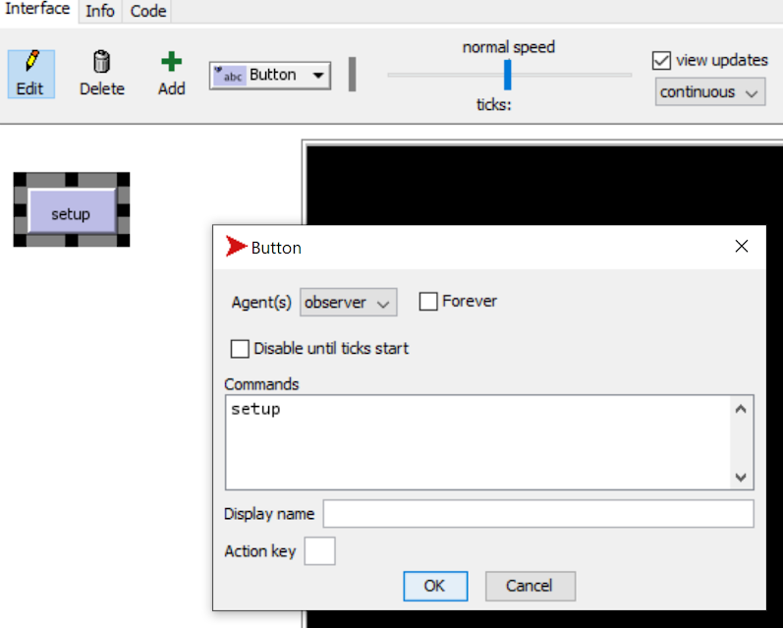
CREATE A NETLOGO ENVIRONMENT
To start a new model, select “New” from the File menu.
Click the “Add” icon
Click wherever you want the button to appear in the empty white area.
Type setup in the box labeled “Commands”.
Similarly, create a “go” button
For Commands enter go instead of setup.
Check the “Forever” checkbox in the edit dialog.
Check the “Disable until ticks start”.

Slide 14
NETLOGO COMPONENTS
The NetLogo world is a two dimensional world that is made up of turtles, patches, links, and an observer.
Patches: Stationary objects arranged in a grid
Turtles: Move over that grid
Links: Connect two turtles
Observer: Oversees everything that’s going on and does whatever the turtles, patches and links can’t
Ticks: Discrete time steps

Slide 15
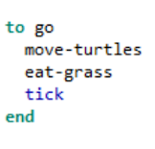
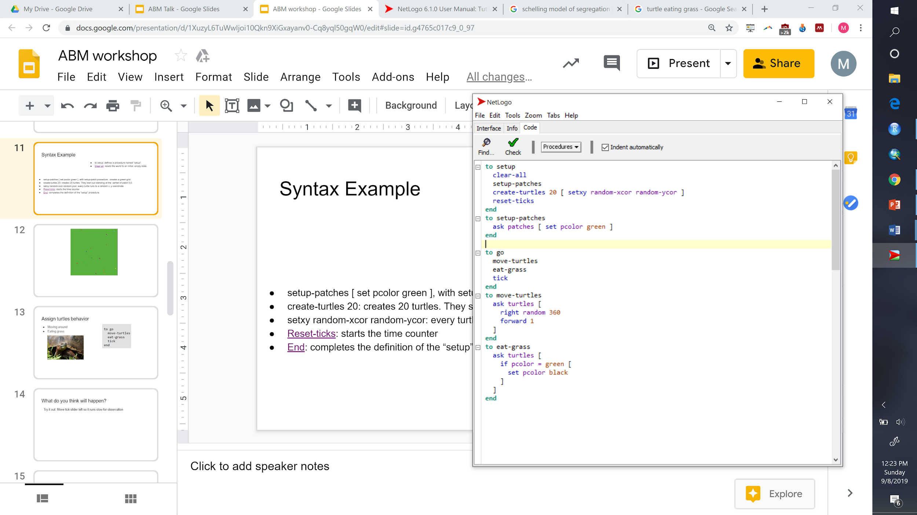
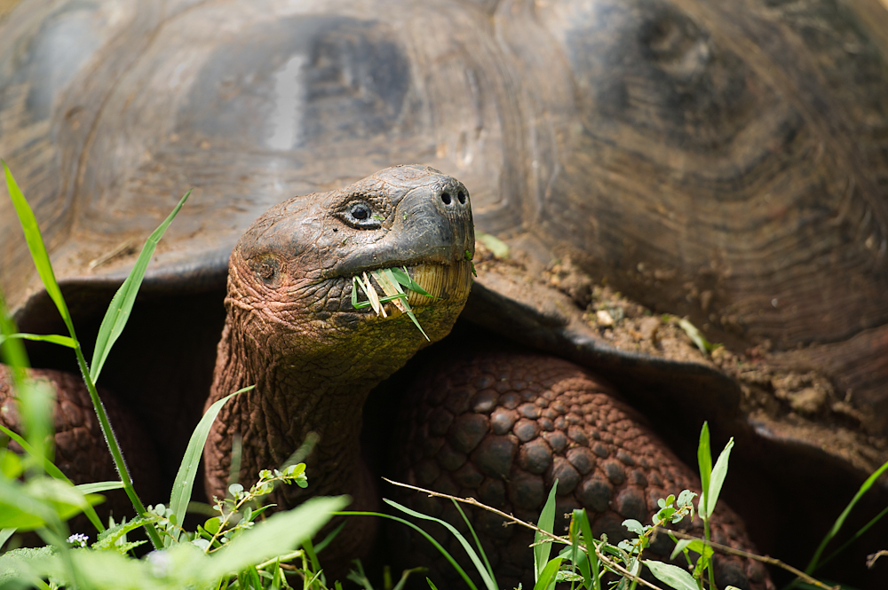
SYNTAX EXAMPLE
Notes:
setup-patches [ set pcolor green ], with setup-patch procedure: creates a green grid
create-turtles 20: creates 20 turtles. They start out standing at the center of patch 0,0.
setxy random-xcor random-ycor: every turtle is placed at a random x, y coordinate
Reset-ticks: starts the time counter
End: completes the definition of the “setup” procedure.

Slide 16
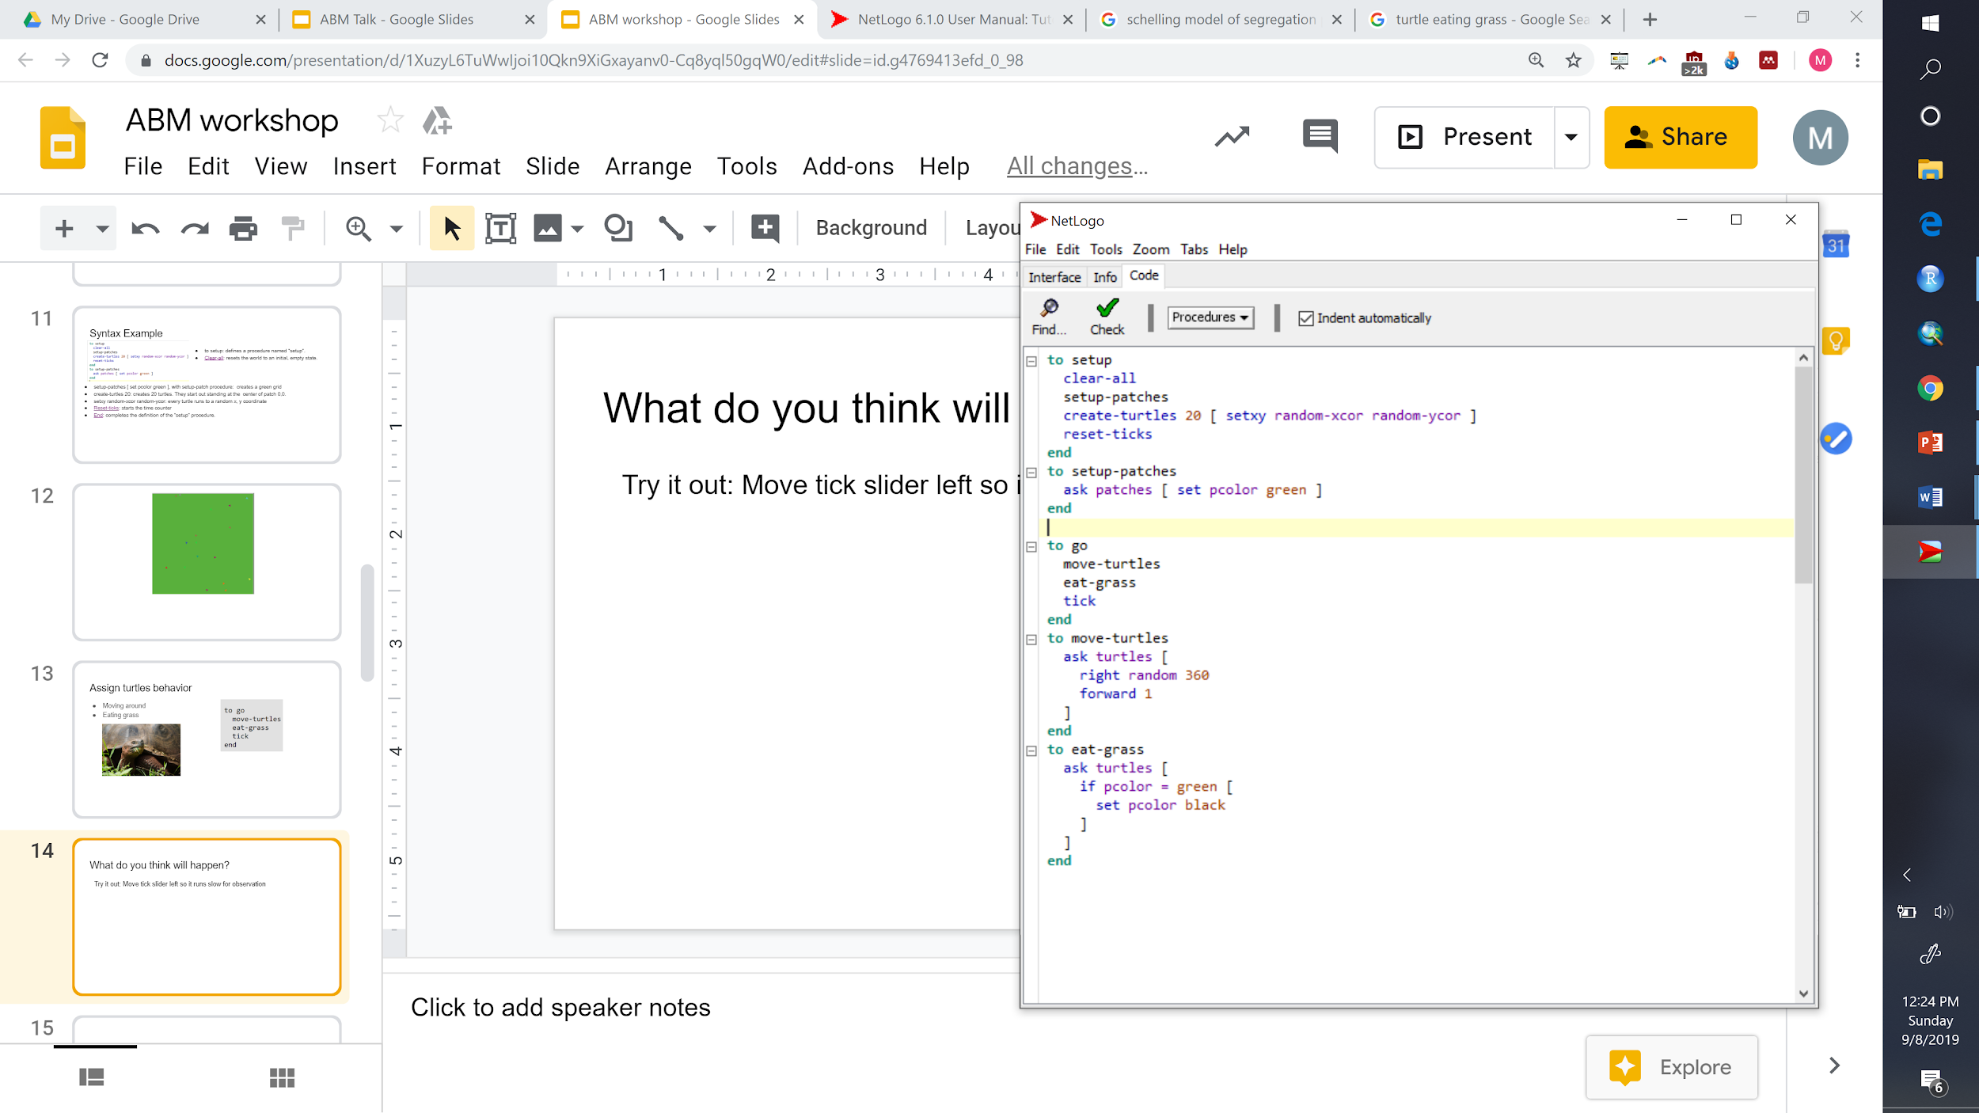
WHAT DO YOU THINK WILL HAPPEN?
Try it out: Move tick slider left so it runs slowly for observation
Notes:
Time: 12:15

Slide 17
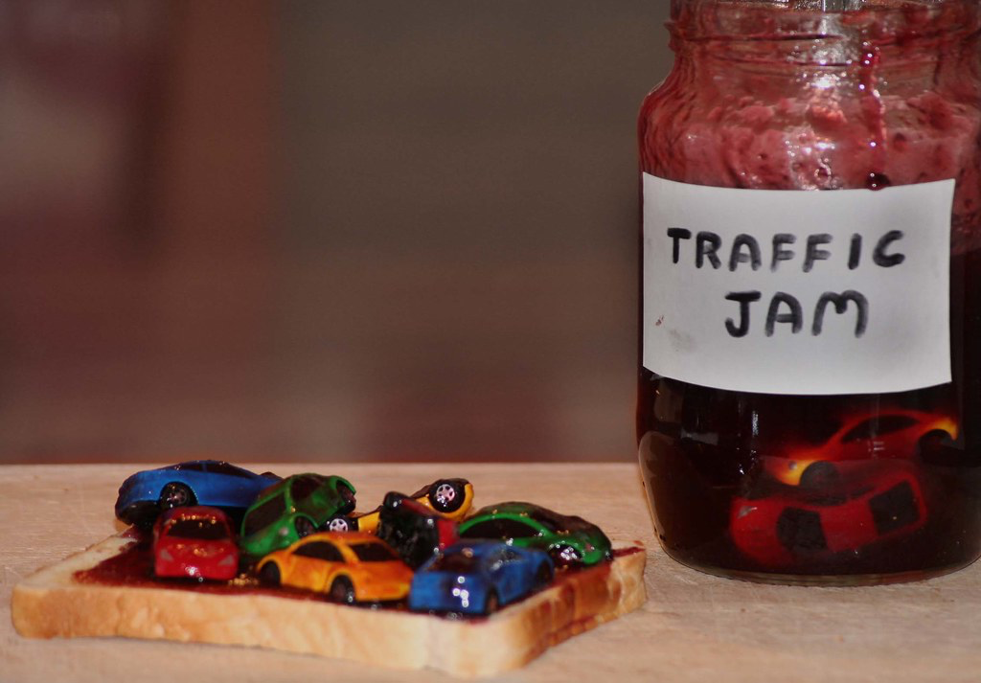
ACTIVITY: EXAMINE A TRAFFIC JAM

Slide 18
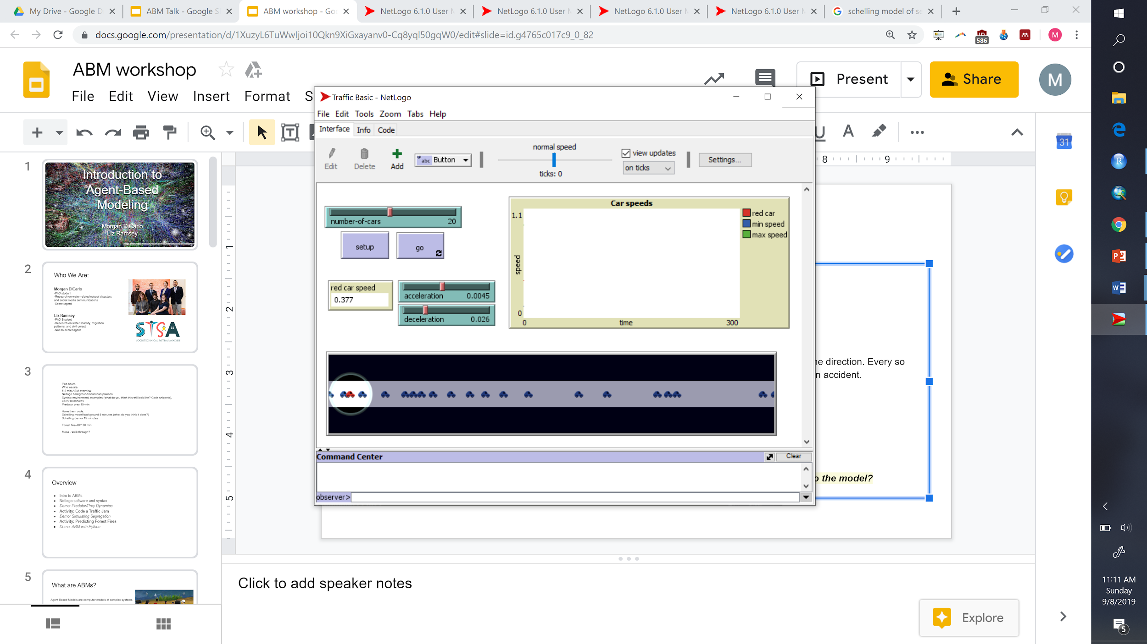
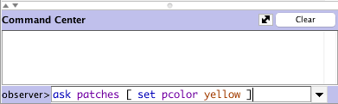
ACTIVITY: EXAMINE A TRAFFIC JAM
Open Traffic Basic, found in the “Social Science” section of Models Library
Run the model for a while to get a feel for it, adjusting the sliders
Showing how traffic jams can form without a specific cause
Discussion Questions:
Set DECELERATION to zero. What happens to the flow?
Gradually increase DECELERATION. When does the flow "break down"?
Notes:
Time 12:45

Slide 19
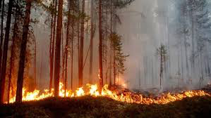
ACTIVITY: MODELING FOREST FIRES
We’re going to code our first ABM!
Notes:
12:30 pm

Slide 20
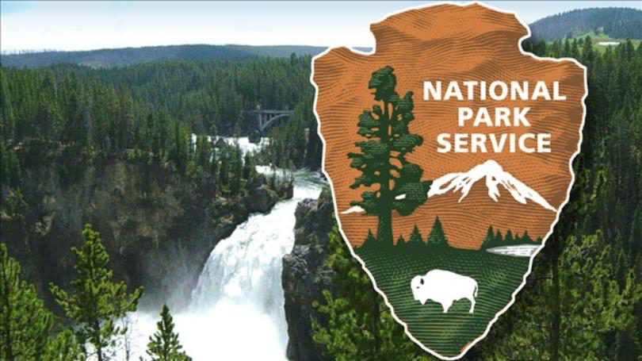
Welcome aboard!

Slide 21

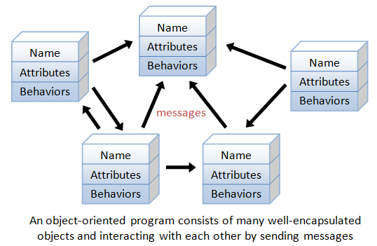
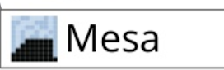
DEMO: ABM WITH PYTHON
The OOP nature of Python is useful for ABM
https://github.com/projectmesa/mesa/blob/master/docs/index.rst

Slide 22


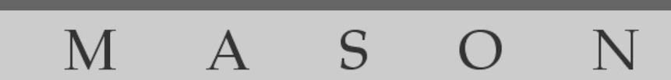


OTHER ABM LANGUAGES TO TRY:

Slide 23
SOURCES
Berglund, E. "Complex Adaptive Systems" CE 791. NC State. Spring 2019.
Evans, A. Agent Based Modelling: Introduction. Retrieved from http://www.geog.leeds.ac.uk/courses/other/crime/abm/general-modelling/index.html
Reynolds, Craig W., Flocks, herds and schools: A distributed behavioral model, 1987
SCHELLING, T. C. (1971). Dynamic models of segregation. Journal of Mathematical Sociology 1: 143-186. [doi:10.1080/0022250X.1971.9989794]
Smith, M. (2018). Advantages and Limitations of agent-based models. Geospatial Analysis 6th Edition. Retrieved from https://www.spatialanalysisonline.com/HTML/index.html?advantages_of_agent-based_mode.htm
Wilensky, U. 1999. NetLogo. http://ccl.northwestern.edu/netlogo/. Center for Connected Learning and Computer-Based Modeling, Northwestern University. Evanston, IL.

